Slide 1
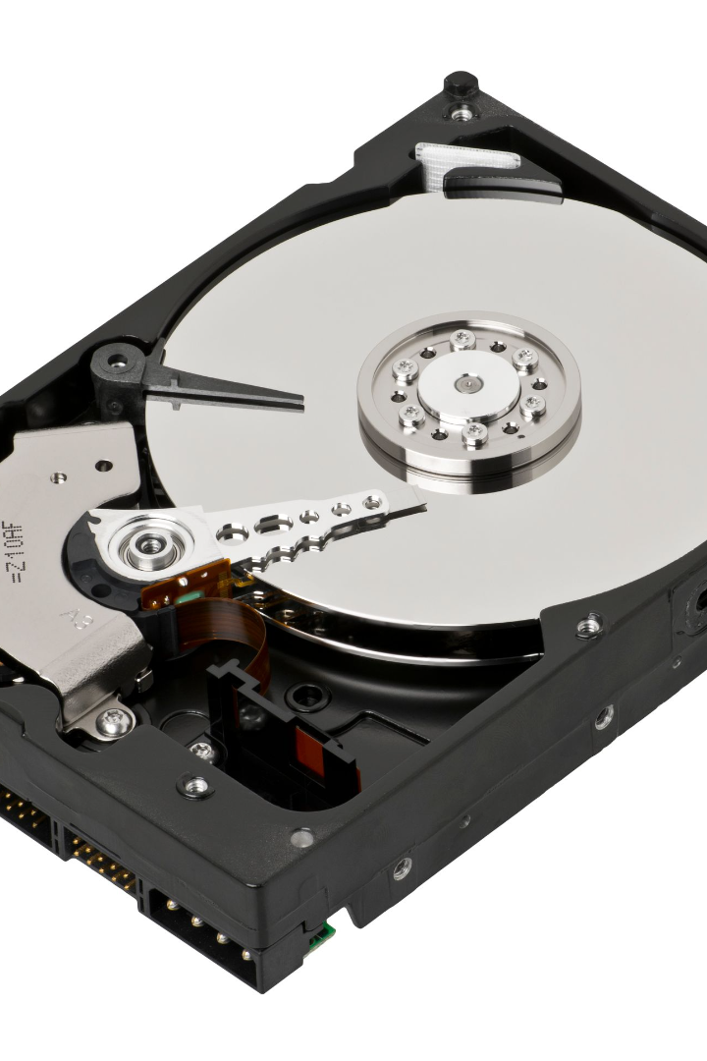


Essential Disk Handling Utilities
Disk handling utilities are critical for efficient storage device management. Let’s explore some widely used tools in Unix-like operating systems.
by Swetha Lakkavattula

Slide 2
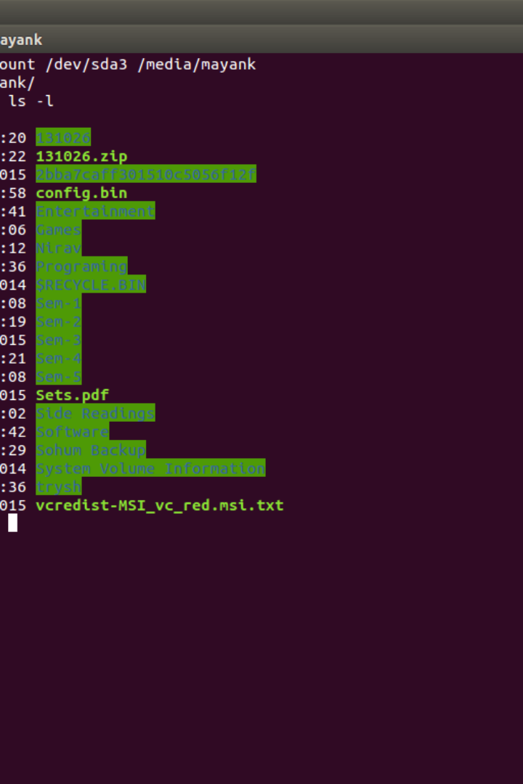
fdisk
fdisk is a powerful command-line tool for managing disk partitions in Linux. With its simple and efficient interface, it's an ideal choice for experienced users.
The fdisk command syntax is straightforward: fdisk [options] device.
To create a new disk partition, type "fdisk /dev/sdX" in the terminal.

Slide 3
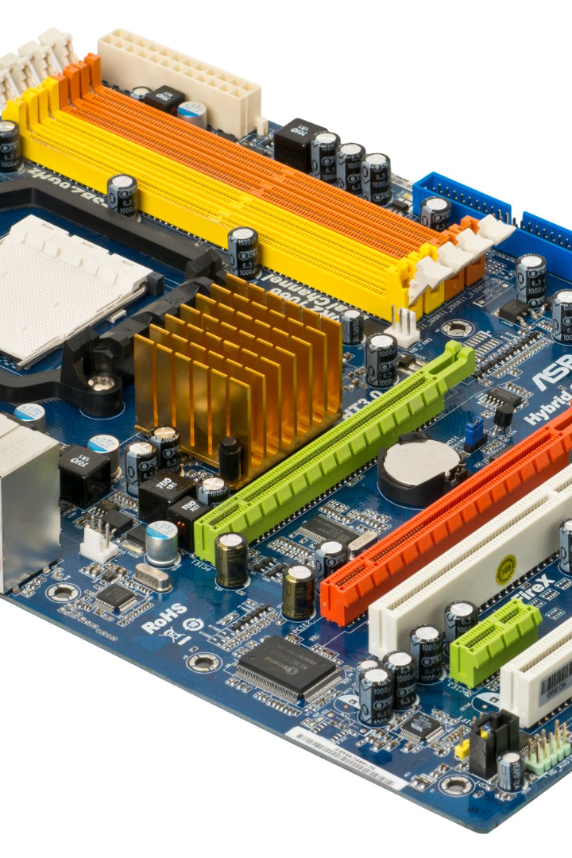
gdisk
gdisk is a variant of fdisk, commonly used for managing GUID Partition Table (GPT) disks with Unified Extensible Firmware Interface (UEFI) systems.
The command syntax is identical to fdisk: gdisk [options] device
To manage GPT disks on your UEFI system, type "gdisk /dev/sdX" in the terminal.

Slide 4
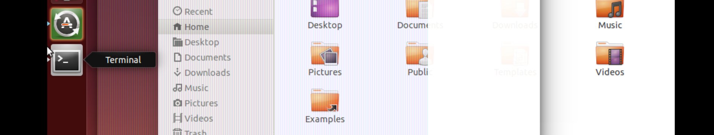
parted
parted is a versatile disk utility tool that provides a user-friendly GUI for creating, resizing, and managing partitions.
The command syntax is straightforward: parted [options] device
To create a new partition using parted, type "parted /dev/sdX" in the terminal.

Slide 5
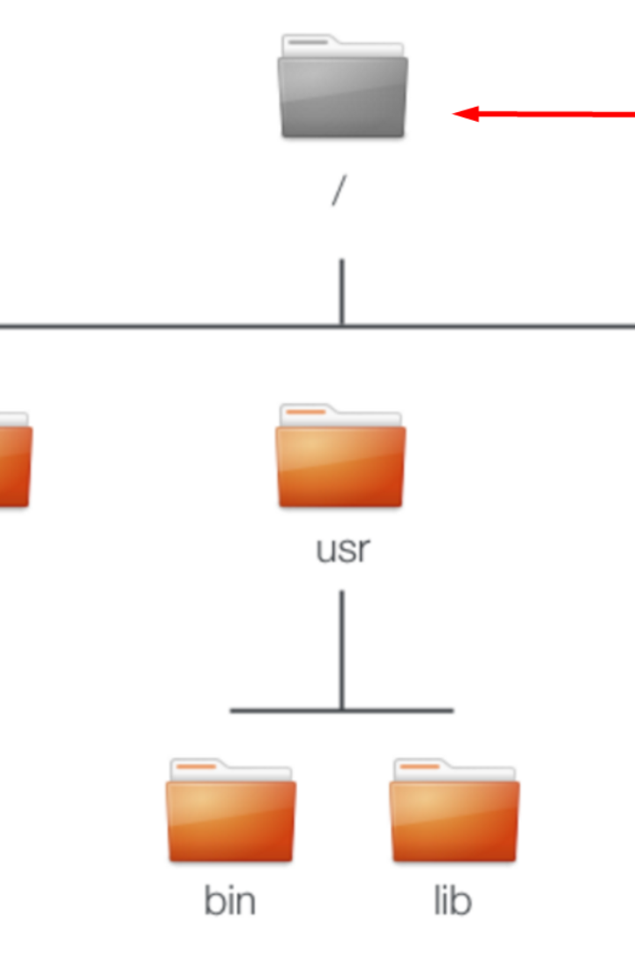
mkfs
mkfs is a command used to create a new file system on a partition or a storage device. It supports numerous filesystems, including EXT4 and NTFS.
The syntax for the mkfs command is simple: mkfs [options] device.
To create a new ext4 file system on /dev/sdXY, type "mkfs.ext4 /dev/sdXY" in the terminal.

Slide 6

mount and umount
Mounting and unmounting are crucial operations that allow the OS to access files on specific directories in the file system hierarchy.
The mount syntax is mount [options] device mount_point. For example, type "mount /dev/sdXY /mnt/data" to mount the /dev/sdXY device at /mnt/data.
The umount command is used to unmount a mounted filesystem. For example, type "umount /mnt/data" to unmount the /mnt/data directory.

Slide 7
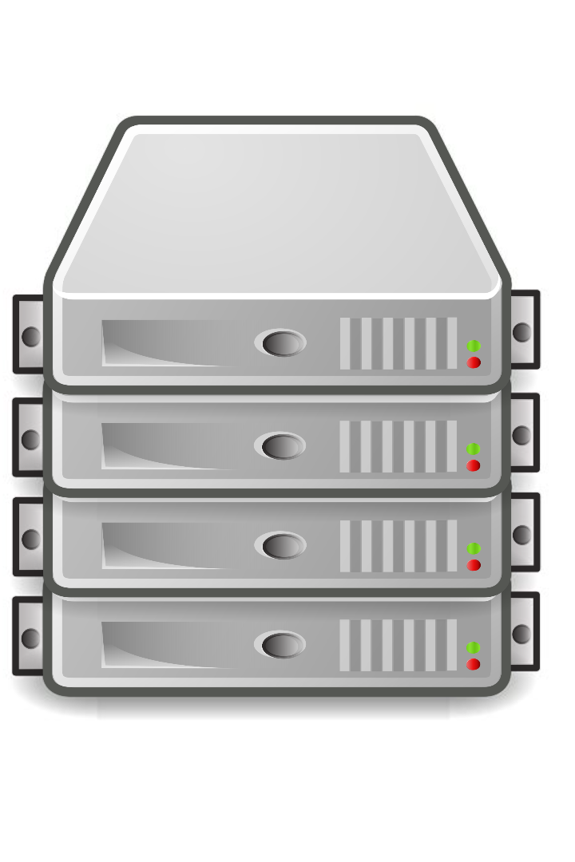
df and du
df and du are two useful disk analysis tools that enable the user to identify the disk space utilization and locate large files or directories.
The df command displays information about disk space usage for mounted filesystems. Type "df -h" to display the disk space usage for all mounted filesystems.
The du command shows the disk usage of files and directories. Use “du -sh /path/to/directory” to calculate the disk usage for a directory and its subdirectories.

Slide 8

dd
dd is a versatile disk imaging tool used to create copies of data between files, partitions, or devices. It is a useful tool for system backup or restoration.
The command syntax is straightforward: dd [options]. For example, "dd if=/dev/sdX of=disk_image.img bs=4M" will create a disk image of /dev/sdX and save it to a file named disk_image.img.

Slide 9

Wrap Up
Disk handling utilities are essential for managing storage devices, partitions, and file systems in OS environments. Proper usage of these tools helps you maintain data integrity and efficiently manage storage.
In this presentation, we discussed a few common yet powerful tools, including fdisk, gdisk, parted, mkfs, mount, umount, df, du, and dd.
Thank you for considering this overview of disk handling utilities.

